Slide 1
Career Counselling
„BOZ“ Career orienteering centre at our school

Slide 2
Career Counselling
careers counsellor about once a month(always the same!)
at school during mornings
talks ~15 minutes
students go alone or in small groups(parents can come as well if they have got time)

Slide 3
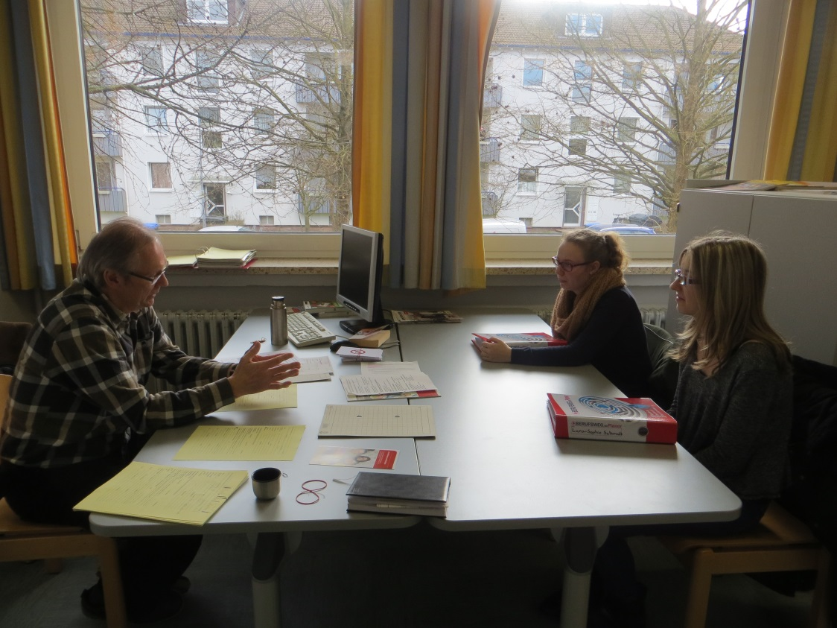
Career Counselling

Slide 4
Career Counselling
Lara and Anna are talking to the careers counsellor

Slide 5
Career Counselling
students present their career plans
career counsellor asks questions
compare reports with plans
c. c. gives advice where to apply
offers special career assessment tests
offers intensive talks at the Employment Agency

Slide 6
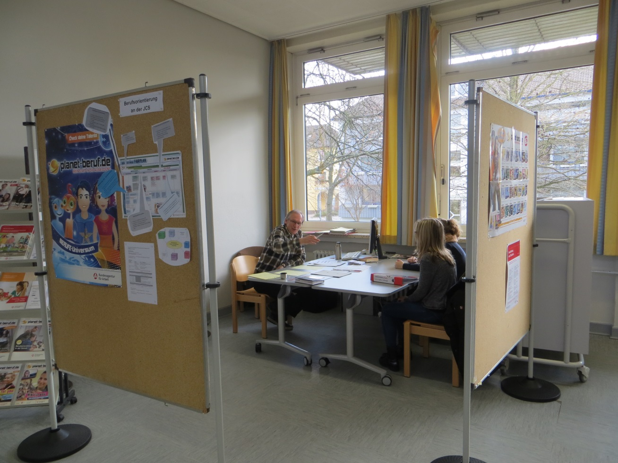
Career Counselling
discuss options for vocational schools
c.c. provides options for practical training
c.c. arranges work placements
c.c. helps with tips for CV

Slide 7
Career Counselling
General remarks
dates are often fully booked
the majority of students visit the c.c. more than once
the help offered is really valuable in the career orienteering process

Slide 8
Career Counselling
What we suggest to our partners:
find out about your career advisory service
make a date with your/a careers counsellor
prepare for that date
tell the others about the consultation
encourage the others to do the same
help to make it a habit at your school

